Slide 1
Syracuse University School of Information Studies Master of Science Applied Data Science Portfolio Milestone
Himadri Tewari hstewari@syr.edu SUID – 227851541 https://github.com/hstewari

Slide 2
Introduction
The Masters in Applied Data Science program at Syracuse University helps the students to learn and implement the application of data science by providing the opportunities to collect data, analyze, do predictive analysis by applying machine learning and data mining techniques and create visualizations.
The skills developed from the program will be demonstrated using some of the projects accomplished in below courses:
IST 652 – Scripting for Data Analysis
IST 736 – Text Mining
IST 707 – Data Analytics
IST 659 – Data Admin Concepts & Database Management

Slide 3
Learning Objectives
Below is the list of Learning Objectives:
1. Describe a broad overview of the major practice areas in data science.
2. Collect and organize data.
3. Identify patterns in data via visualization, statistical analysis, and data mining.
4. Develop alternative strategies based on the data.
5. Develop a plan of action to implement the business decisions derived from the analyses.
6. Demonstrate communication skills regarding data and its analysis for managers, IT professionals, programmers, statisticians, and other relevant professionals in their organization.
7. Synthesize the ethical dimensions of data science practice (e.g., privacy).

Slide 4

IST 652 – Scripting for Data Analysis
Analysis of New York City Current Job Postings

Slide 5
Introduction
The objective of the project is to analyze the current job posting data of New York City. The data collected need to be processed and organized. Once the data is processed, then it is cleaned by correcting any incomplete, duplicate or error related to the data. After that, the data will be explored to identify the trends, hidden pattern, design charts, and visuals.
Data Set – The dataset is collected from the Kaggle which contains job posting available in the City of New York’s official job site.
Programming – Python, Jupyter Notebook

Slide 6
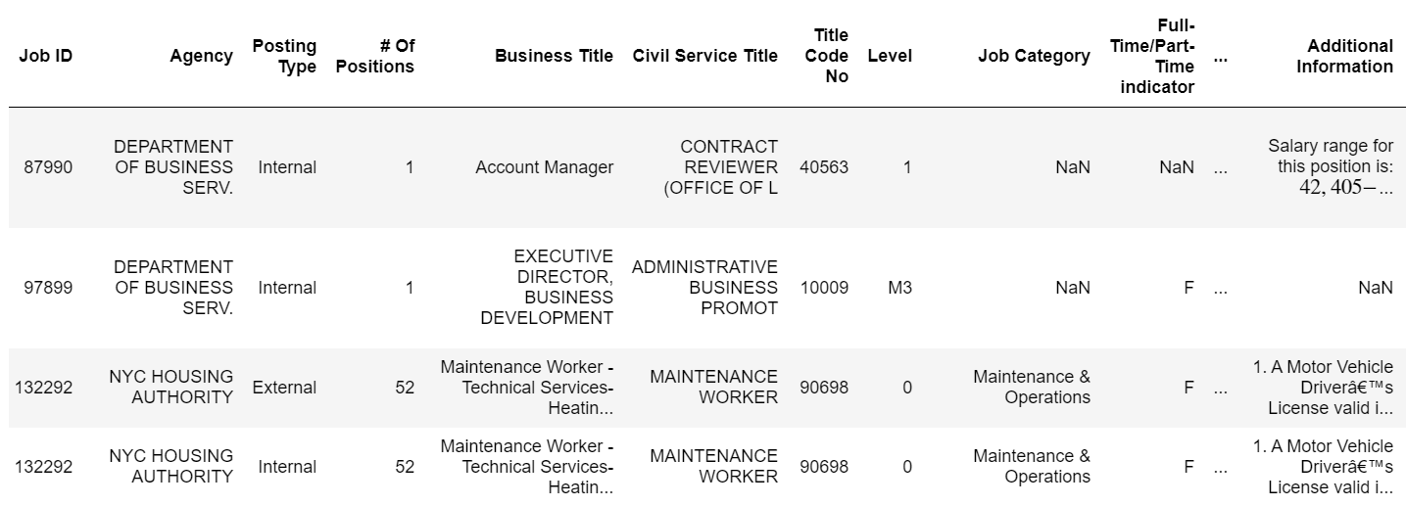
Data Analysis
The data collected was processed using the following libraries . Pandas are imported for data manipulation and analysis. Numpy is imported for scientific computation. Matplotlib and seaborn are imported for visualization purpose. Wordcloud is imported to generate the word-cloud. NLTK is imported for stopwords. “re” library is imported for the regular expression. Gmap is imported to visualize the map. The dataset was collected in CSV format, so to read the data, pandas ‘read_csv’ function was used.

Slide 7
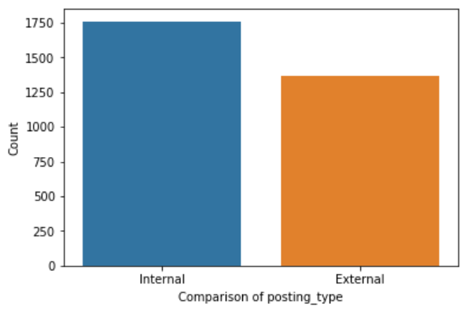
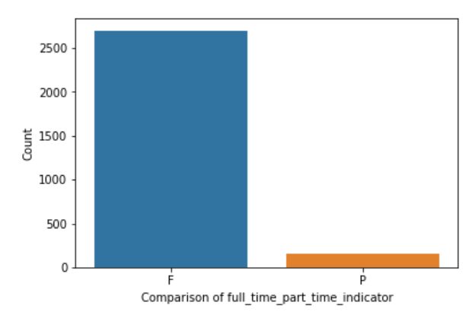
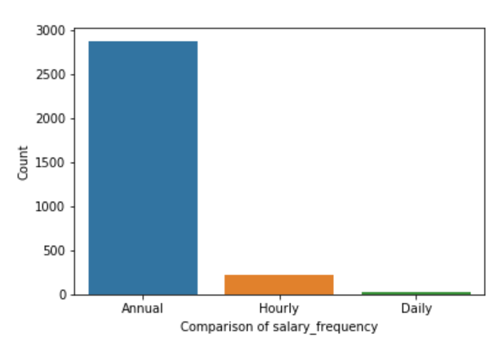
Data Analysis
As part of the data analysis process, data comparison was done for Posting Types, Full Time/Part-Time Indicator and Salary Frequency

Slide 8
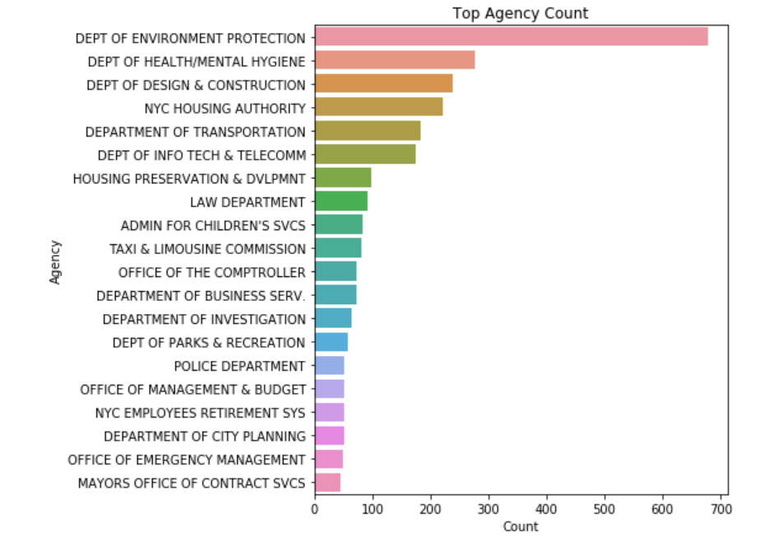
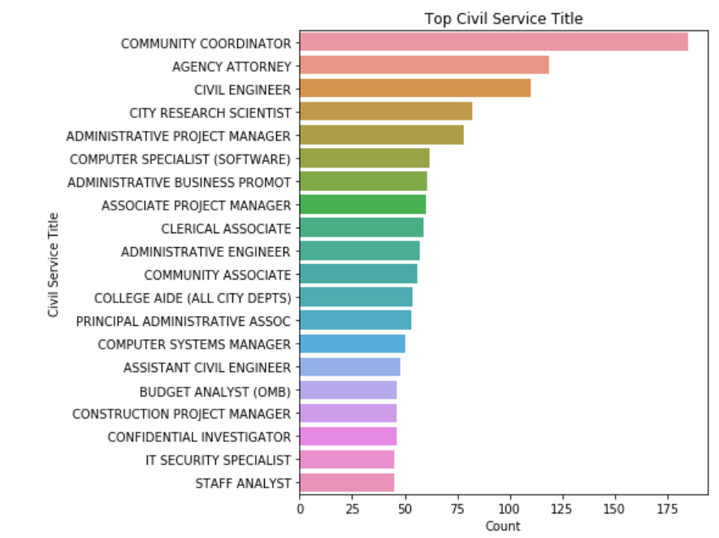
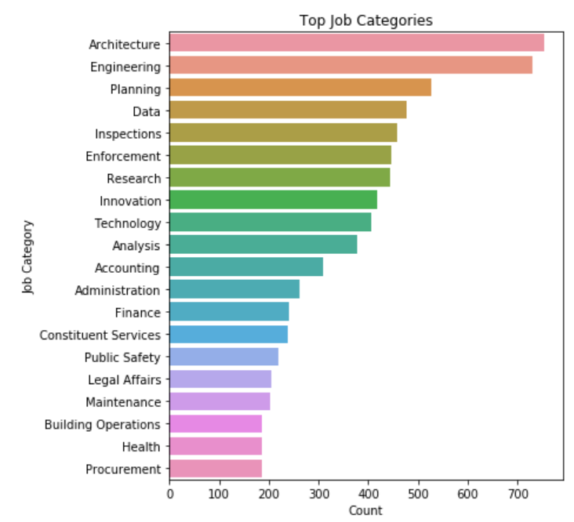
Data Analysis
The next analysis was done to find out the top counts of attributes like Agency, Civil Service Title and Job Categories.

Slide 9
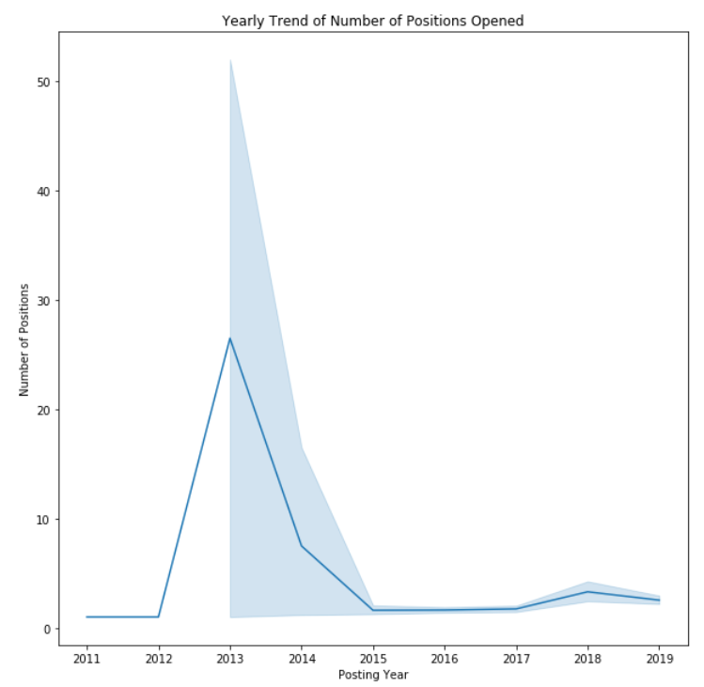
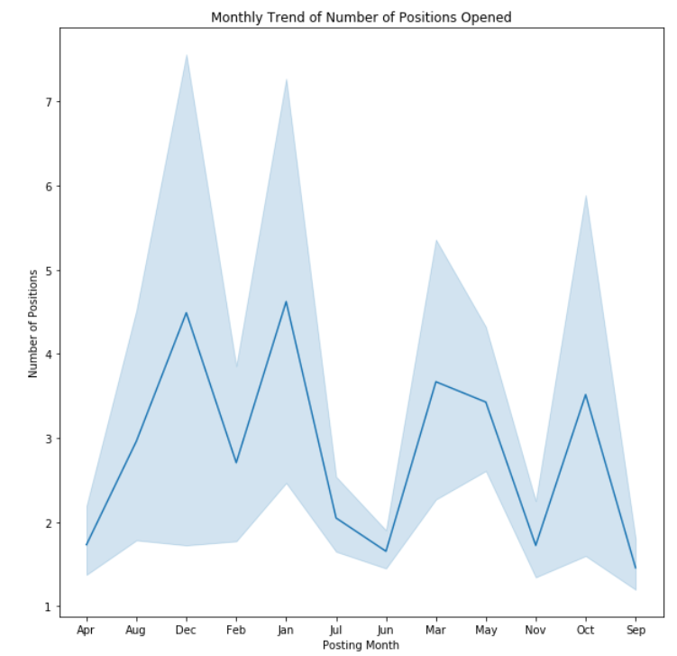
Data Analysis
The date columns – posted date, process date, and posting date were converted into date-time objects. From the posted date column, the year and the months were extracted and added as two separate columns. Using the month and year column, yearly and monthly trend of the number of positions were visualized.

Slide 10
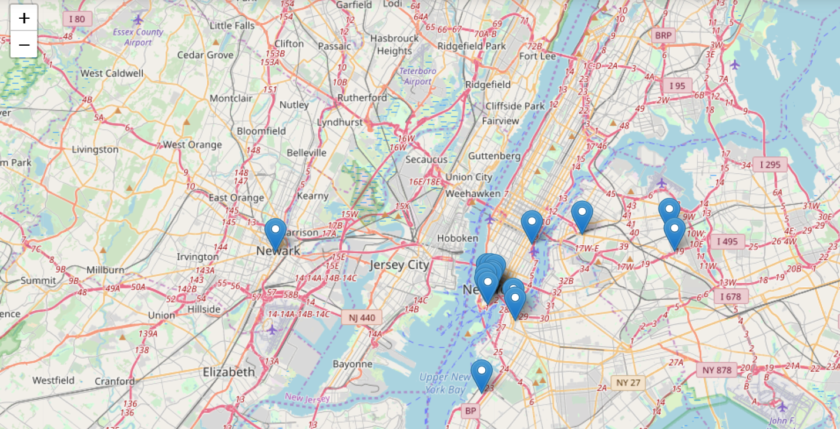
Word Cloud
To do the map-based spatial analysis, the work address and the counts were then converted to dataframe. Using the geopy library, the coordinates of the address were generated. The coordinates column was then broken into two more columns – latitude and longitude. Then, using the folium library, the agency’s work address was generated on the map.

Slide 11
Achievements
The project provided an opportunity to collect external data, converting it by cleaning, transforming and modeling with the objective of identifying useful information, suggesting collections and supporting decision making.
Identify the trends, hidden pattern, design charts, and visuals and help the organization to take correct strategic decision.
User privacy is taken care in the project. It does not contain any personal information

Slide 12
IST 736 – Text Mining
Analysis of Employee Reviews: Amazon, Apple, Facebook, Google, Microsoft and Netflix

Slide 13
Introduction
The growing activity of web users has led to a rapid rise in the amount of textual information. As ever more textual information becomes available, it turns out that meaningful information is hard to obtain from huge masses of textual data. To handle this, methods of text mining are designed specifically for processing and analyzing vast amounts of texts. The growing activity of web users has led to a rapid rise in the amount of textual information. As ever more textual information becomes available, it turns out that meaningful information is hard to obtain from huge masses of textual data. To handle this, methods of text mining are designed specifically for processing and analyzing vast amounts of texts. The goal of this project was to apply text mining techniques to employee reviews analysis.
Data Set – Over 67k employee reviews for Google, Amazon, Facebook, Apple, Netflix and Microsoft are collected from Kaggle dataset. The data is originally collected from Glassdoor – a website where current and former employees anonymously review companies and their management.
Programming – Python, Jupyter Notebook

Slide 14
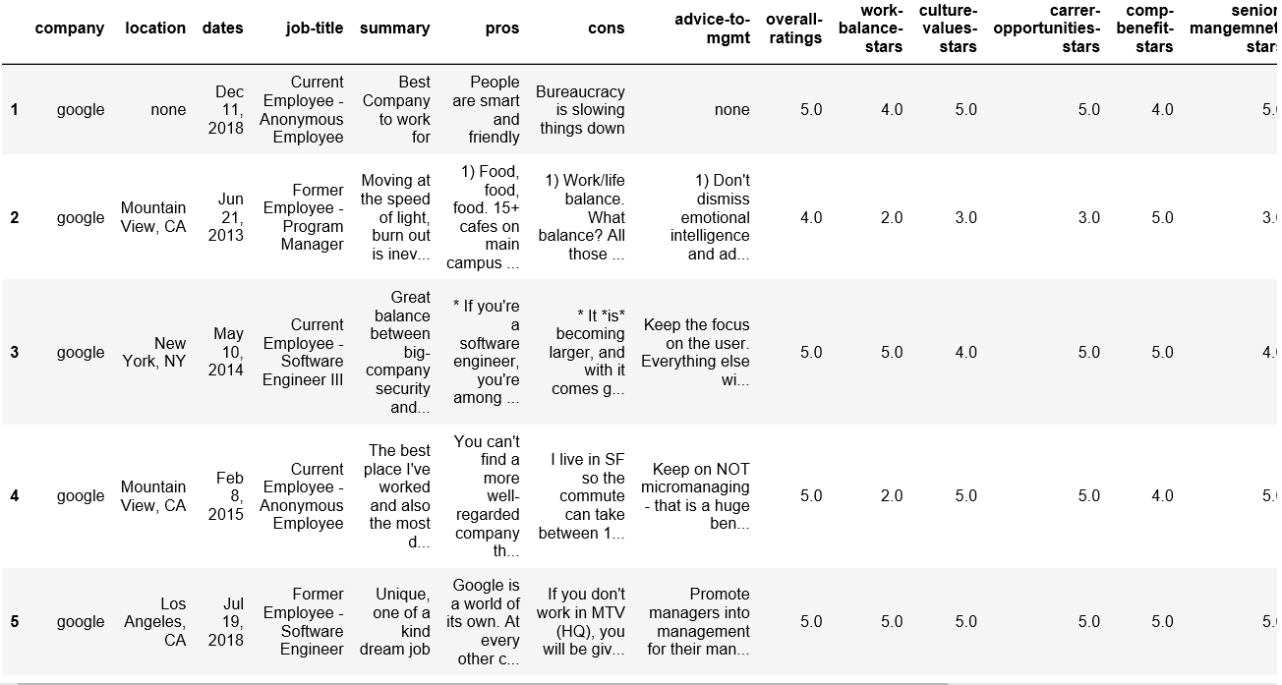
Data Analysis
Random is imported for cross-validation and splitting the data into train and test set. Pandas is imported for data manipulation and analysis. Numpy is imported for scientific computation. Matplotlib and seaborn are imported for visualization purpose. Wordcloud is imported to generate the word-cloud. Sci-kit and NLTK are imported for data preprocessing and model formation. The dataset was collected in CSV format, so to read the data pandas ‘read_csv’ function was used. After loading the dataset, the data-frame was summarized and the first five rows were analyzed.

Slide 15
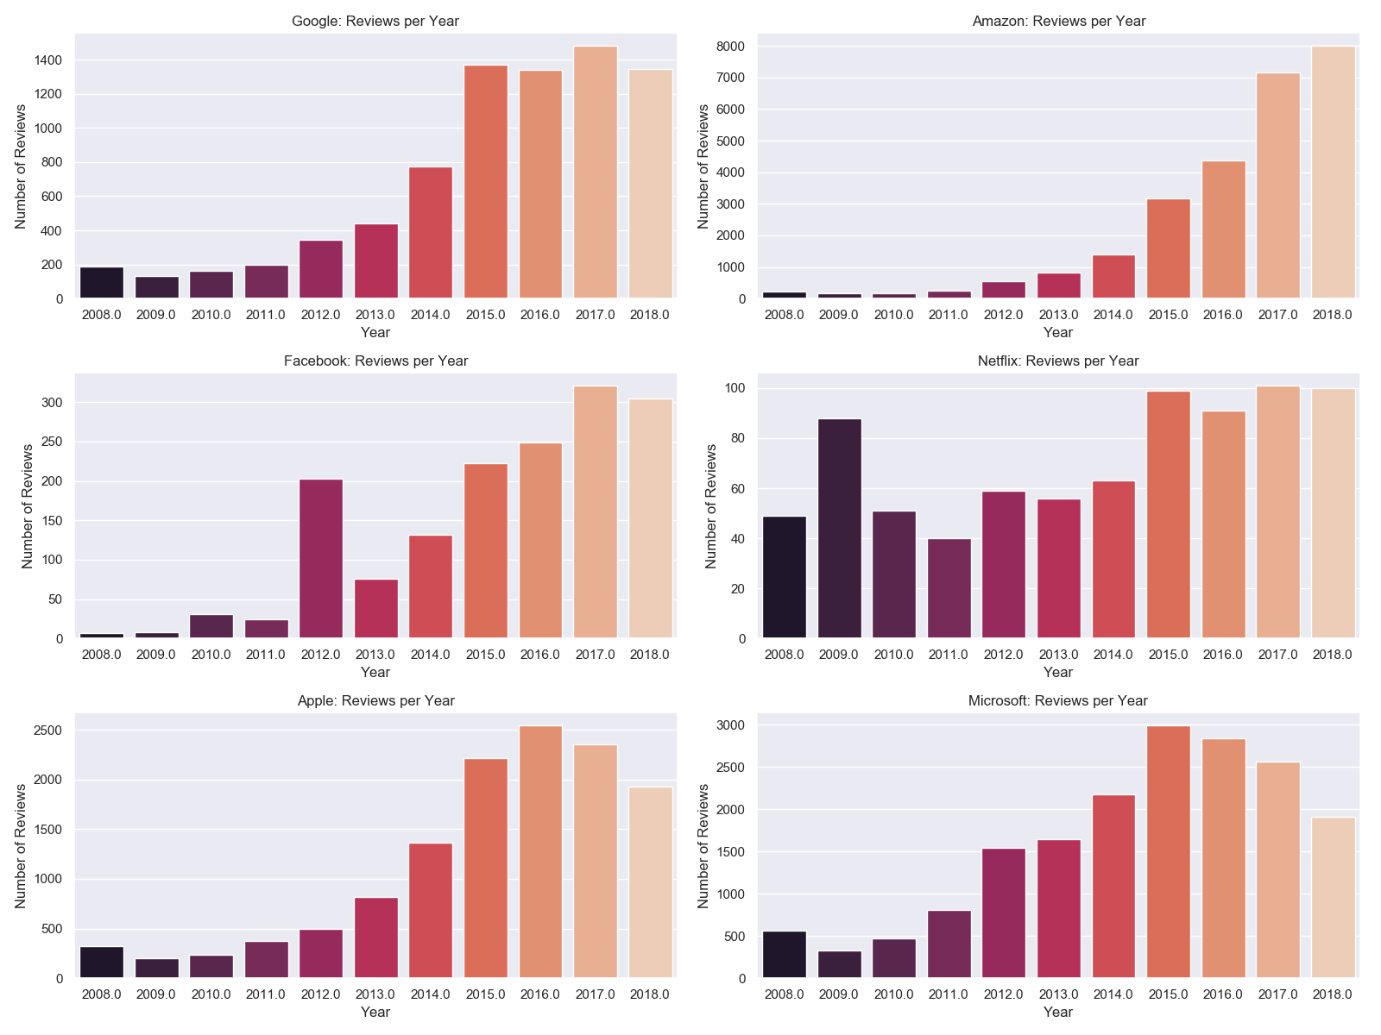
Data Analysis
As part of the data analysis process, review comments per year were compared for each of the company.

Slide 16
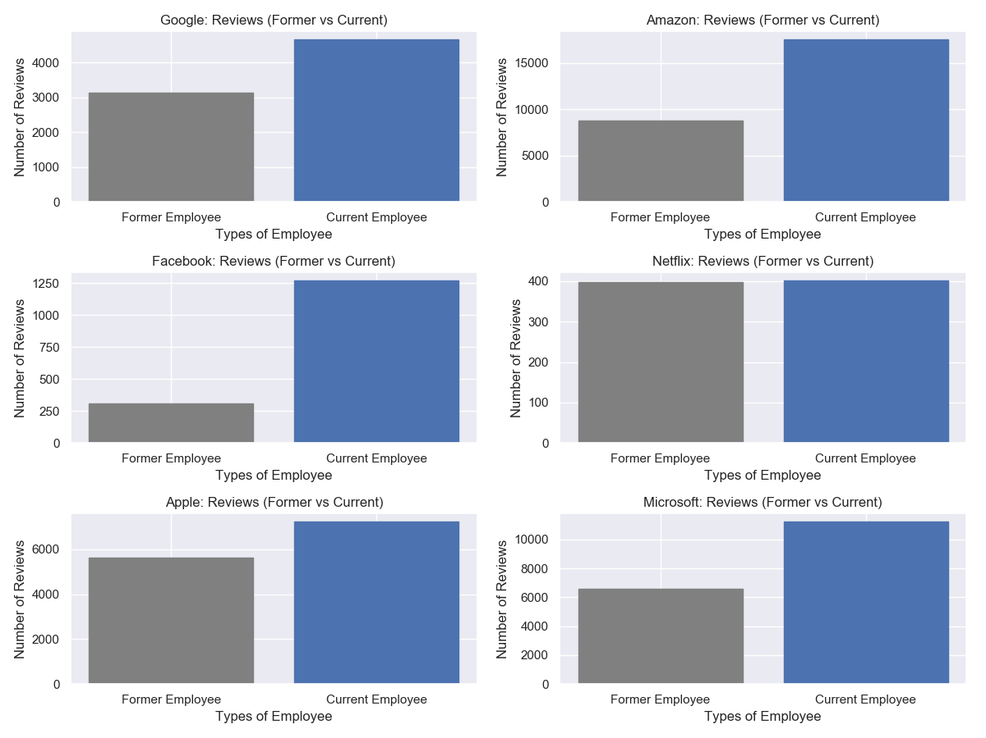
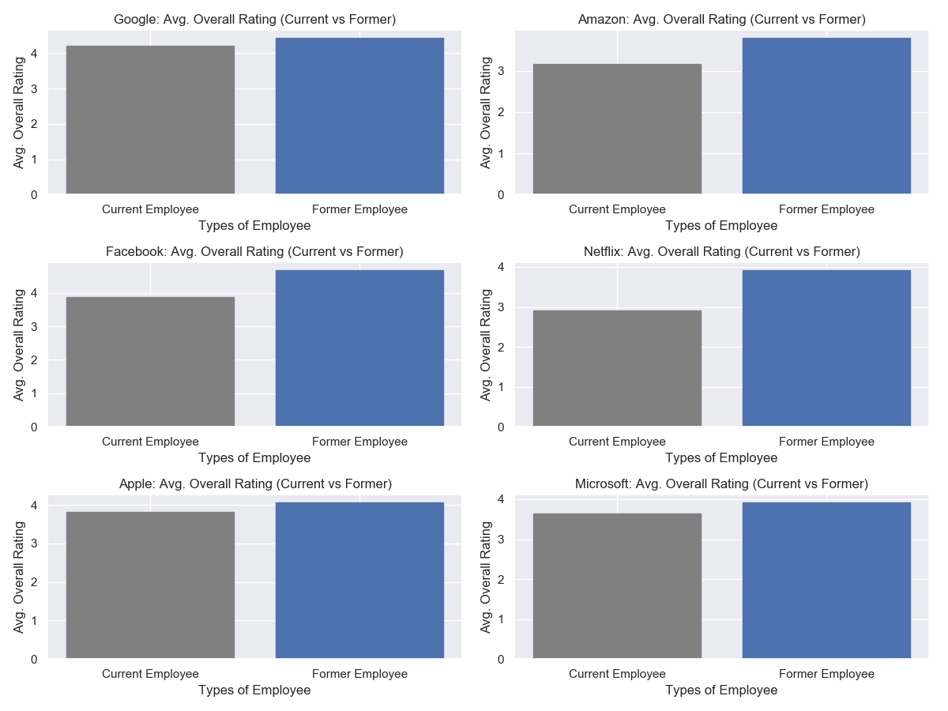
Data Analysis
The next analysis was done to find out the review count per employee type and overall rating per employee type.

Slide 17
Methodology
This work also aims to investigate whether a model can learn from the data to correctly recognize the employee attitude based on pure textual information. In the contrast between Multinomial Naive Bayes (MNB) and Support Vector Machines (SVMs), the performance is not only the exact prediction results but also the time cost.
In terms of the text representation, two popular approaches, Term Frequency (TF) and Term Frequency-Inverse Data Frequency (TF-IDF), are involved based on the n-gram term distribution. In this work, 1-gram denotes unigram and 2-gram denotes bigram.
MNB achieved 87.3% accuracy with the alpha as 1.0. The same model trained on both unigram and bigram feature maps got 86.3% accuracy. When it came to the TF-IDF bigram vectorization, the accuracy rose back to 87.3%.
SVM can achieve 88.5% accuracy for unigram word features and increased to 88.6% with the assistance of both unigram and bigram text vectorization.

Slide 18
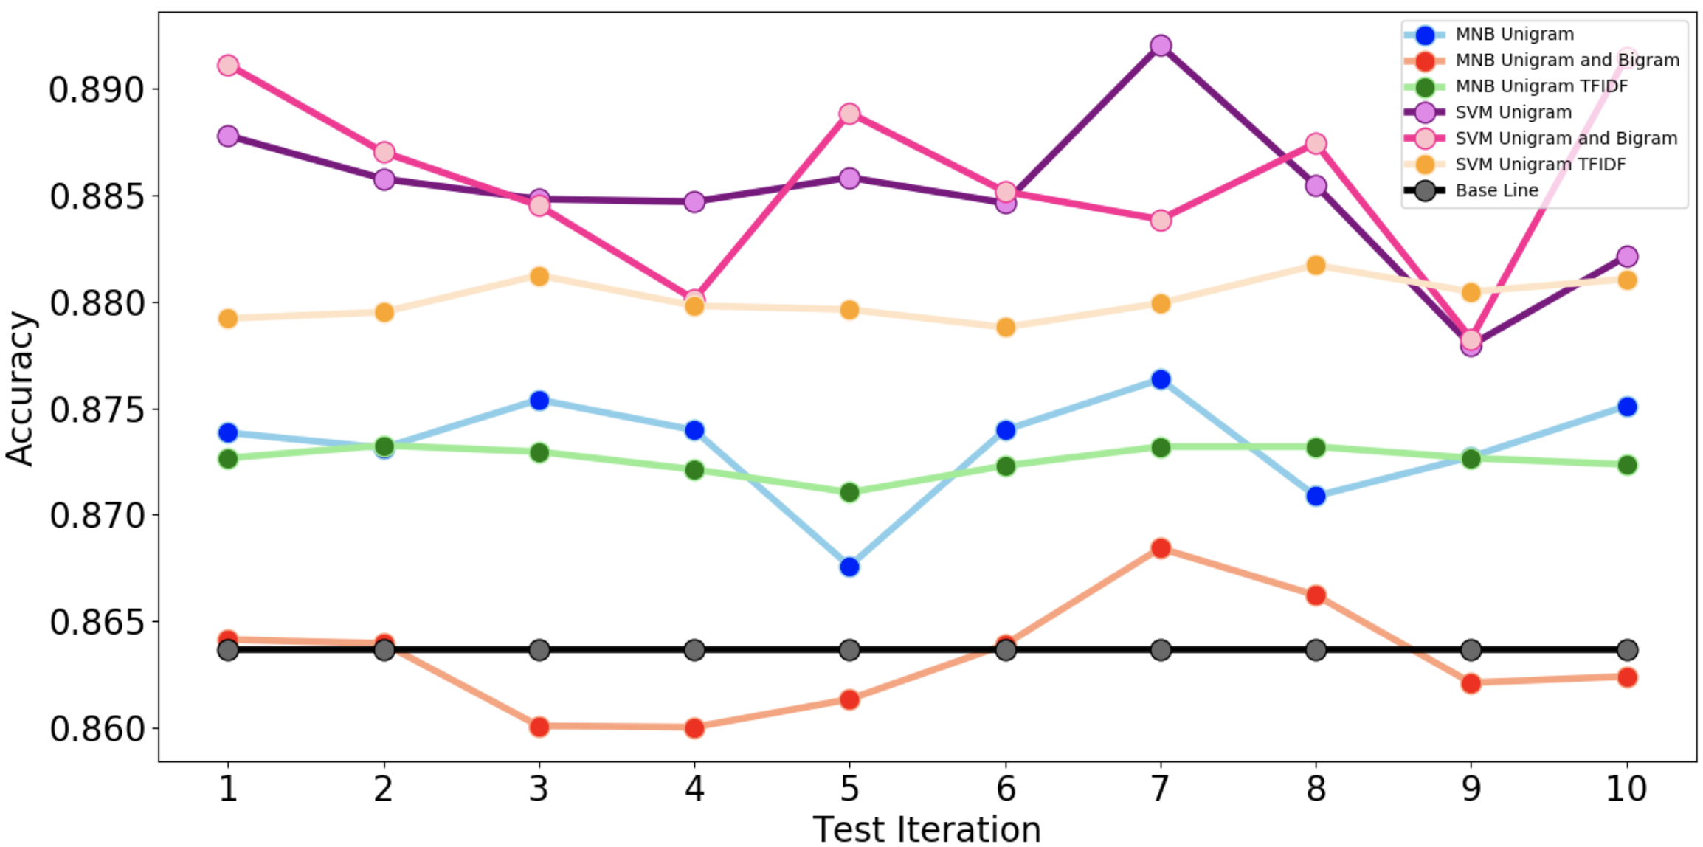
Methodology
Best - SVM with Uni & Bi Count vectorizer achieved 0.886 average accuracy over 10 folds cross-validation. SVM basically is better than MNB
Model\Vectorizer | Uni Count |  | Uni & Bi Count |  | Uni & Bi TFIDF
MNB | 0.873 | +/- 0.002 | 0.863 | +/- 0.003 | 0.873 | +/- 0.001
SVM | 0.885 | +/- 0.003 | 0.886 | +/- 0.004 | 0.880 | +/- 0.001

Slide 19
Achievements
The project provided an opportunity to collect external data, converting it by cleaning, transforming and modeling with the objective of identifying useful information, suggesting collections and supporting decision making.
Identify the trends, hidden pattern, design charts, and visuals and help the organization to take correct strategic decision.
The result indicates the importance of using different text mining and data mining techniques to develop accurate prediction models.
User privacy is taken care in the project. It does not contain any personal information

Slide 20
IST 707 – Data Analytics
Prediction of Readmission Rates in U.S Hospitals

Slide 21
Introduction
The objective of the project was to study the different factors that contribute to the readmission of patients and was able to infer that the physicians from certain departments like the Neoplasms department need to diagnose and order the right test results at the right time.
The dataset was collected from the health facts database which represents 10 years of clinical care data. The original dataset has about 100,000 rows of data. Dataset was reduced to 50,000 rows since the original one is too large. Also, another main reason is the fact that the dataset is imbalanced with more number of records of patients who were not readmitted than patients who were readmitted (9:1 ratio). This was leading to higher accuracy rates but was unable to detect readmitted patients with accuracy.
Programming – R Studio

Slide 22
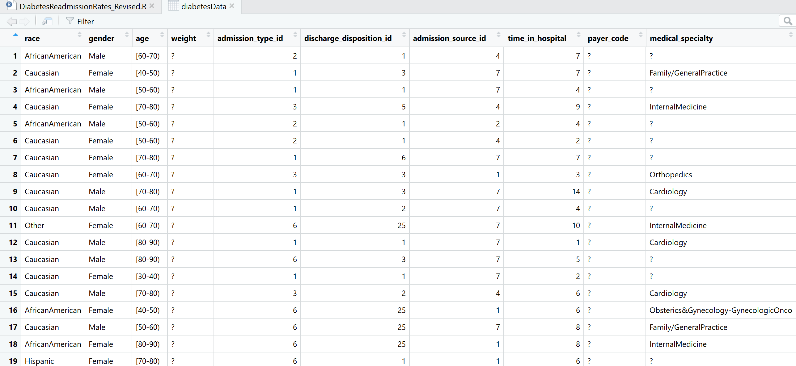
Data Analysis
The data was cleaned as much as possible before doing any sort of analysis on the data. Unimportant attributes like encounter id and patient number were removed since they are not going to contribute anything to the analysis. The dataset was viewed to see and make sense of the attributes present.

Slide 23
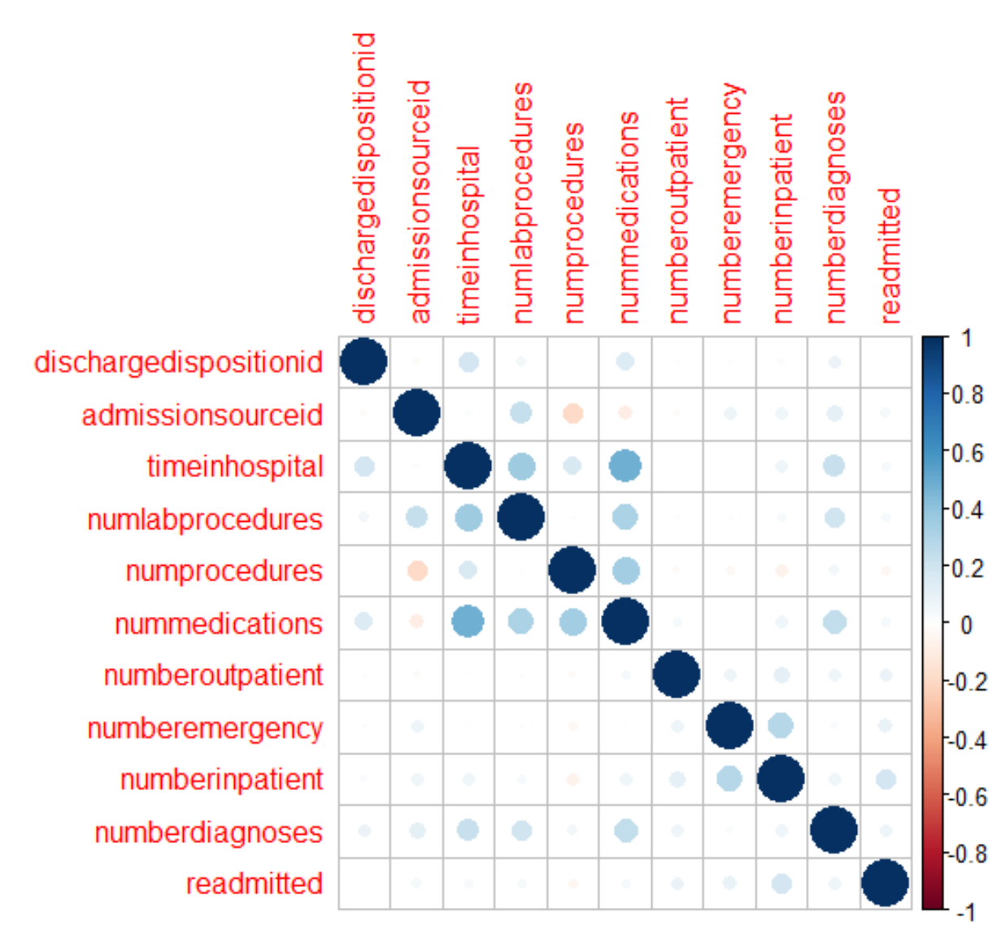
Correlation Matrix
A correlation matrix was visualized to understand the correlations between integer variables and possibly eliminate one of the pairs with high correlations.
Notes:
The matrix shows that there is a strong positive correlation between the variables nummedications and timeinhospital denoting that when the number of days a patient spends in the hospital increases, the number of medications administered to the patient also increases which makes intuitive sense. So, removing one of these variables for further analysis will prevent skewing. Variable nummedications was removed in this case.

Slide 24
Methodology
Different data mining techniques were applied to predict the model performance with different precision and efficiency.
Association Rule Mining, K-means Clustering, Decision Tree, Naïve Bayes, and SVM classification was applied.
Naïve Bayes, Decision Tree and SVM were compared with respect to computation time and accuracy to predict.

Slide 25
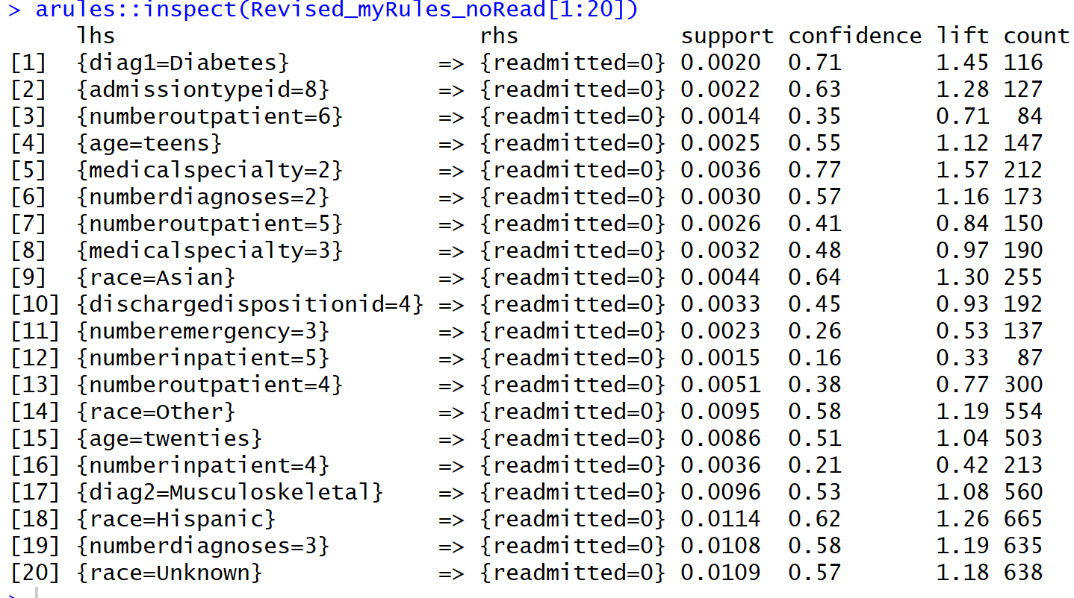
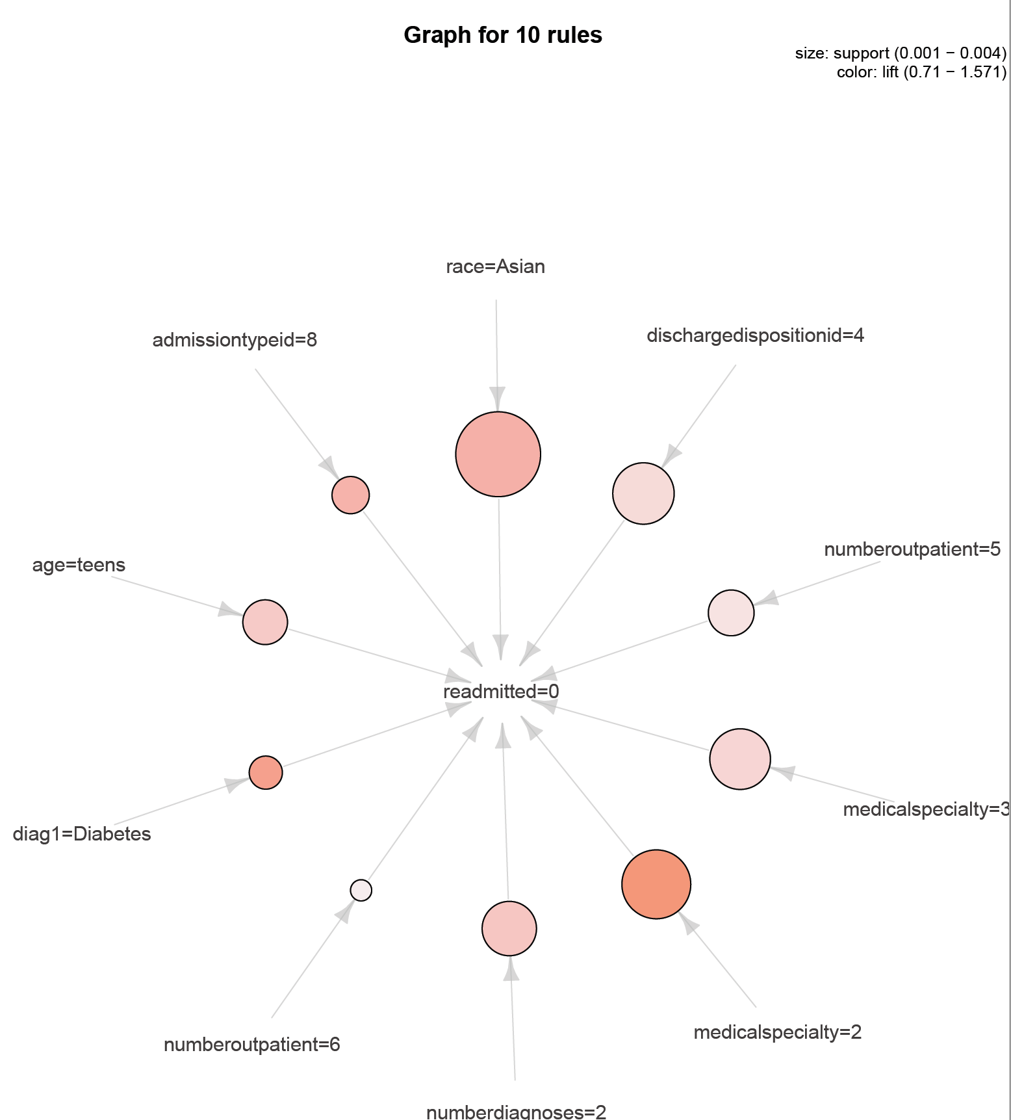
Methodology
The association rule mining shows associations for patients who are not getting readmitted. There is strong confidence, support, and lift for the rule which shows that patients who are admitted by a physician from Gynaec dept don’t get readmitted in the future. There is also a strong lift and support Asian patients associated with no readmission.

Slide 26
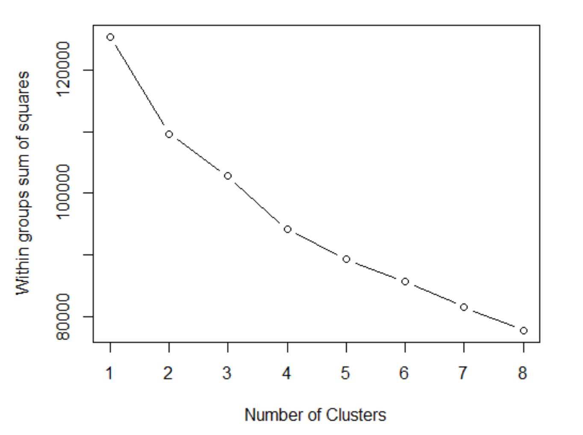
Methodology
Next technique that we applied was K-means clustering. An Elbow plot was used to determine K. We can see from the plot that 4 or 5 is the optimal value for clustering.

Slide 27
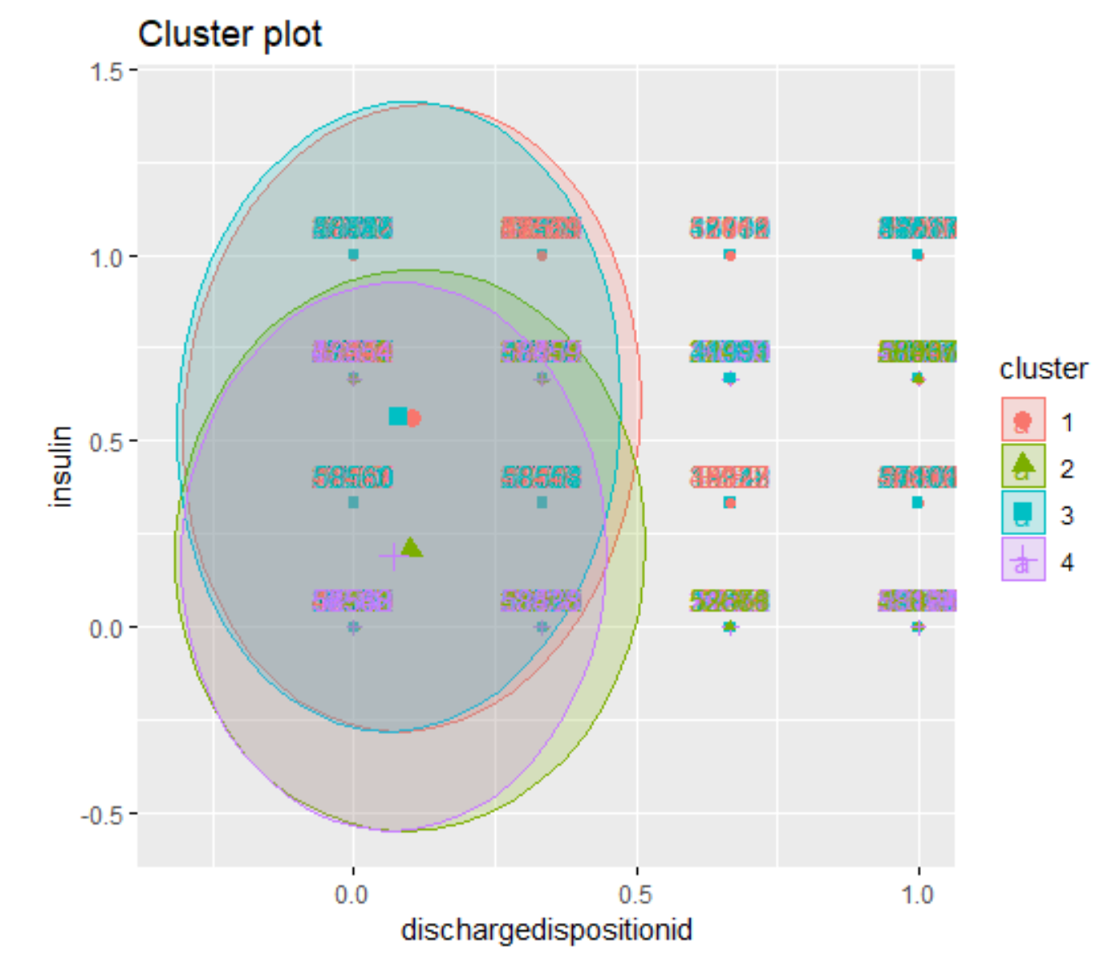
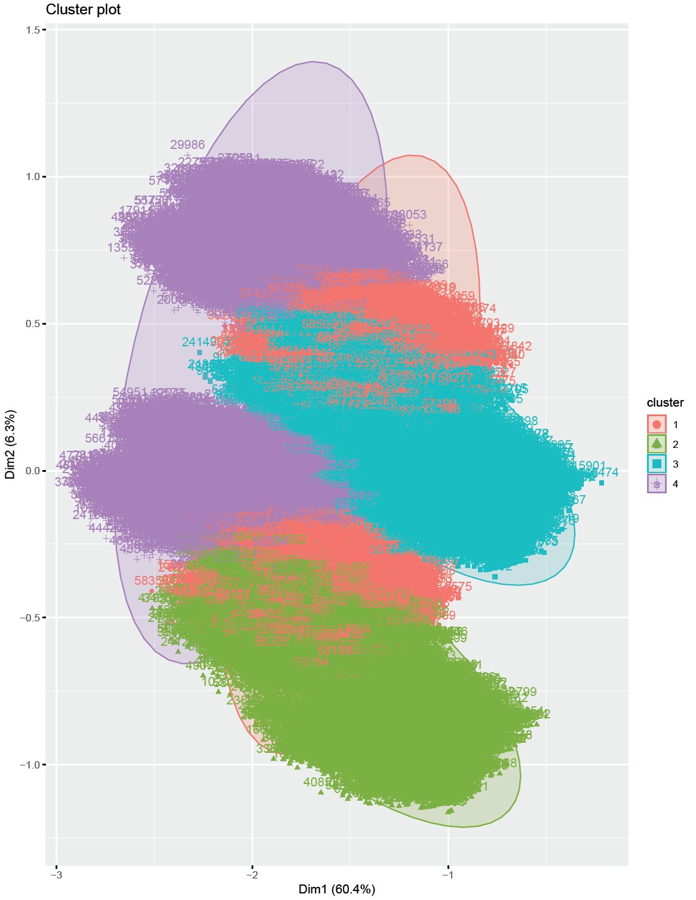
Methodology
The first cluster shows the clustering between two specific variables discharge id which means where the patient was discharged to and insulin levels administered to the patient. The second plot used PCA to reduce the dimensions into two variables that explain 66% of the variation.
Notes:
In the first cluster, looks like the clusters are grouped in the lower x-axis meaning that the patients who were discharged to home after diagnosis are the ones with varying insulin levels.

Slide 28
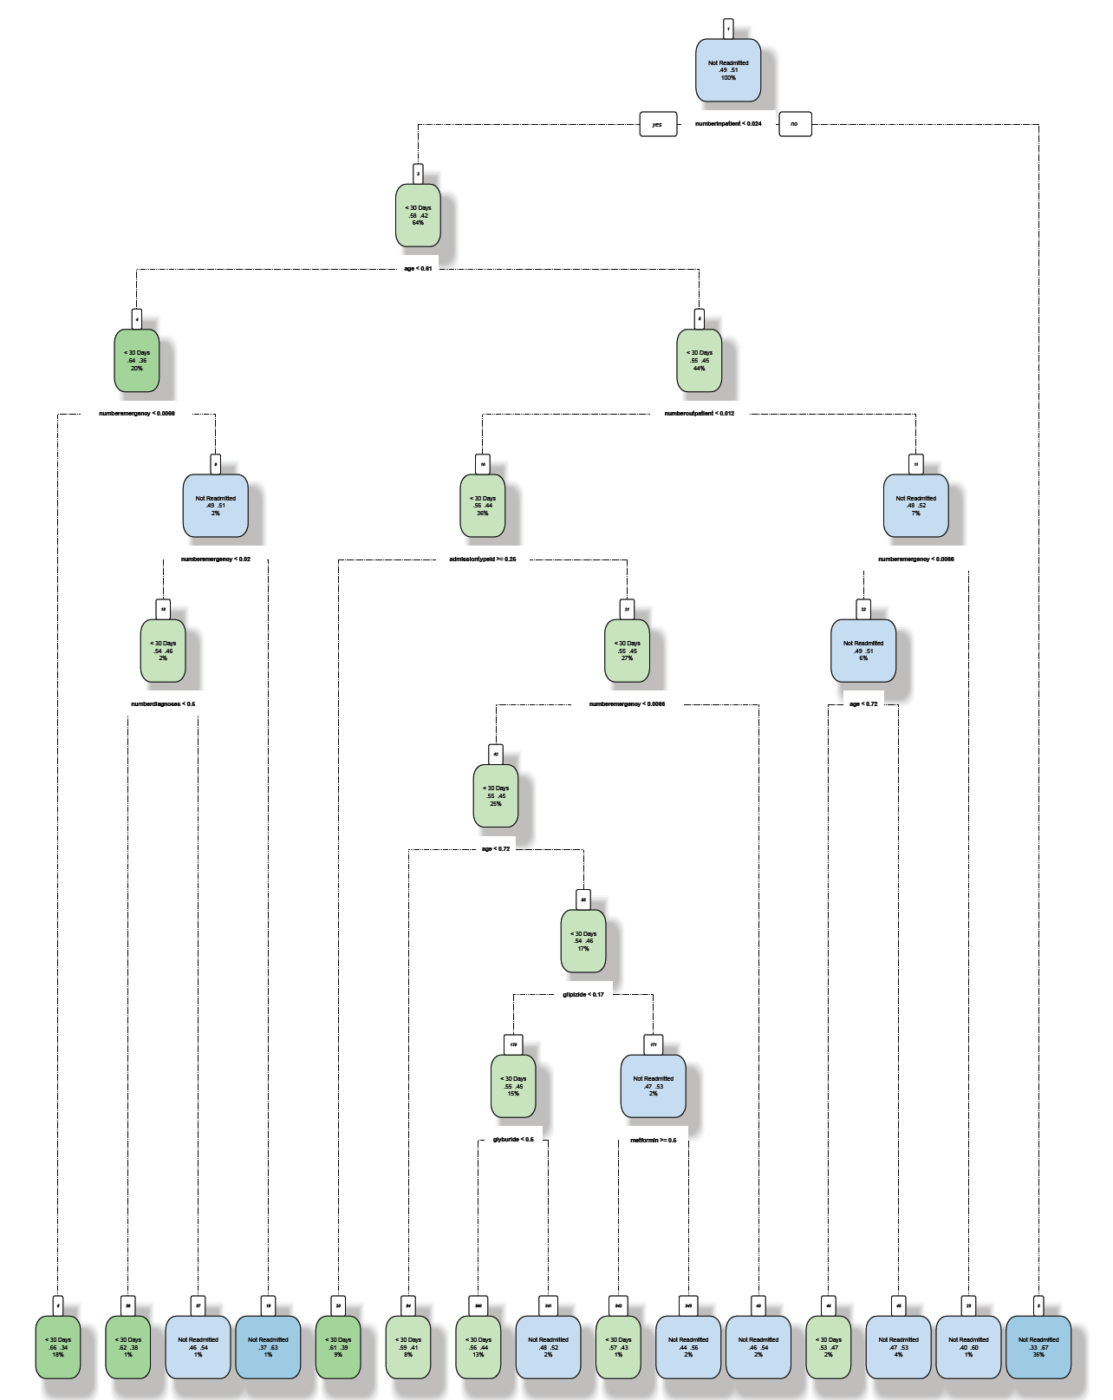
Methodology
Normalized Dataset; Readmitted column has 2 factors, accuracy is 61%, kappa is 0.22 whereas Accuracy is 53%, kappa is 0.16 when readmitted is recoded with 3 factors. Categorical Dataset; accuracy is 56% and kappa is 0.11.

Slide 29
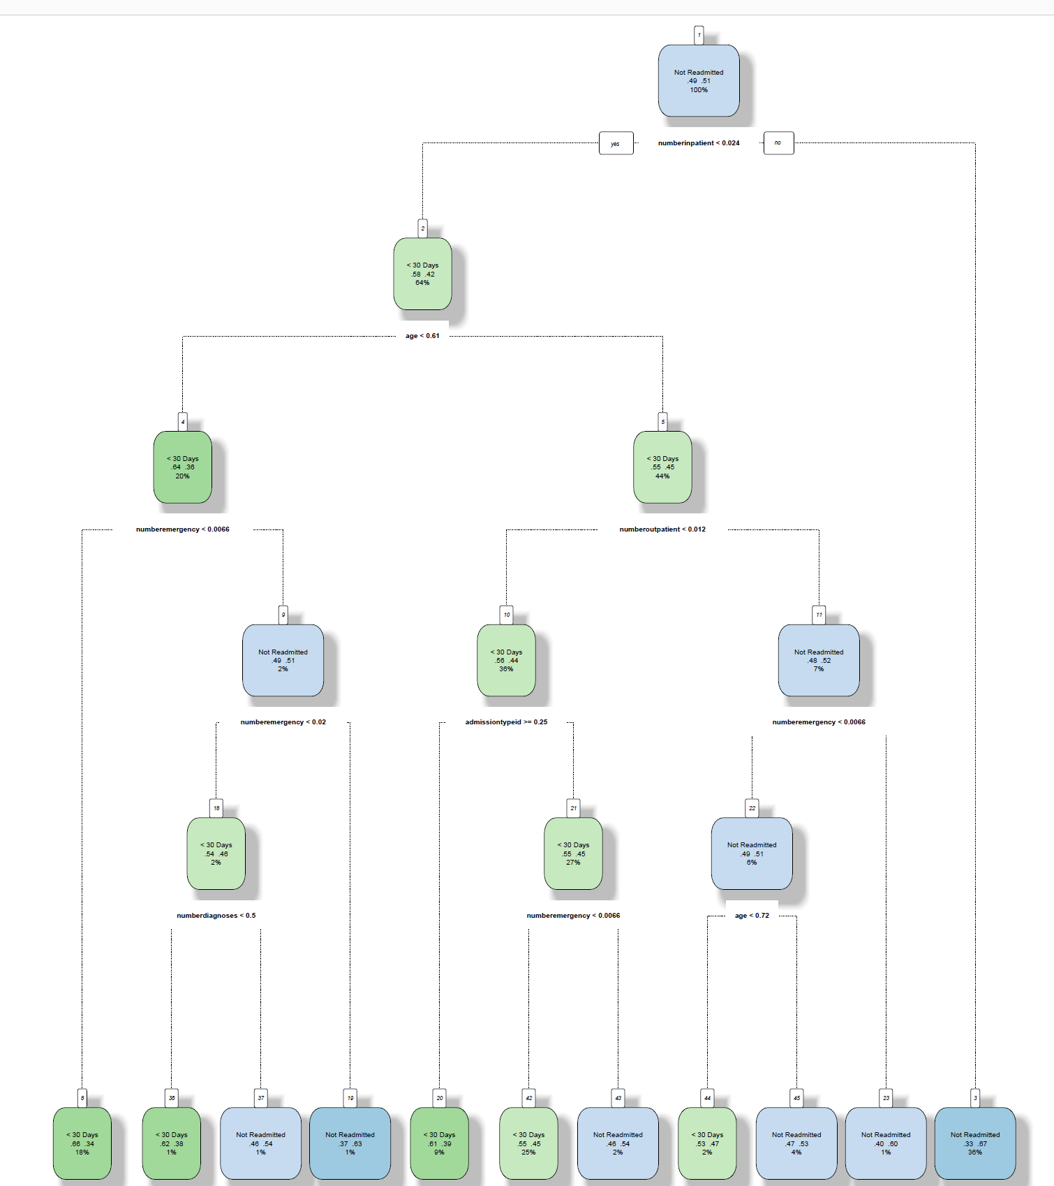
Methodology
Decision Tree with fewer important variables improved the accuracy to 61% with a kappa of 0.22.

Slide 30
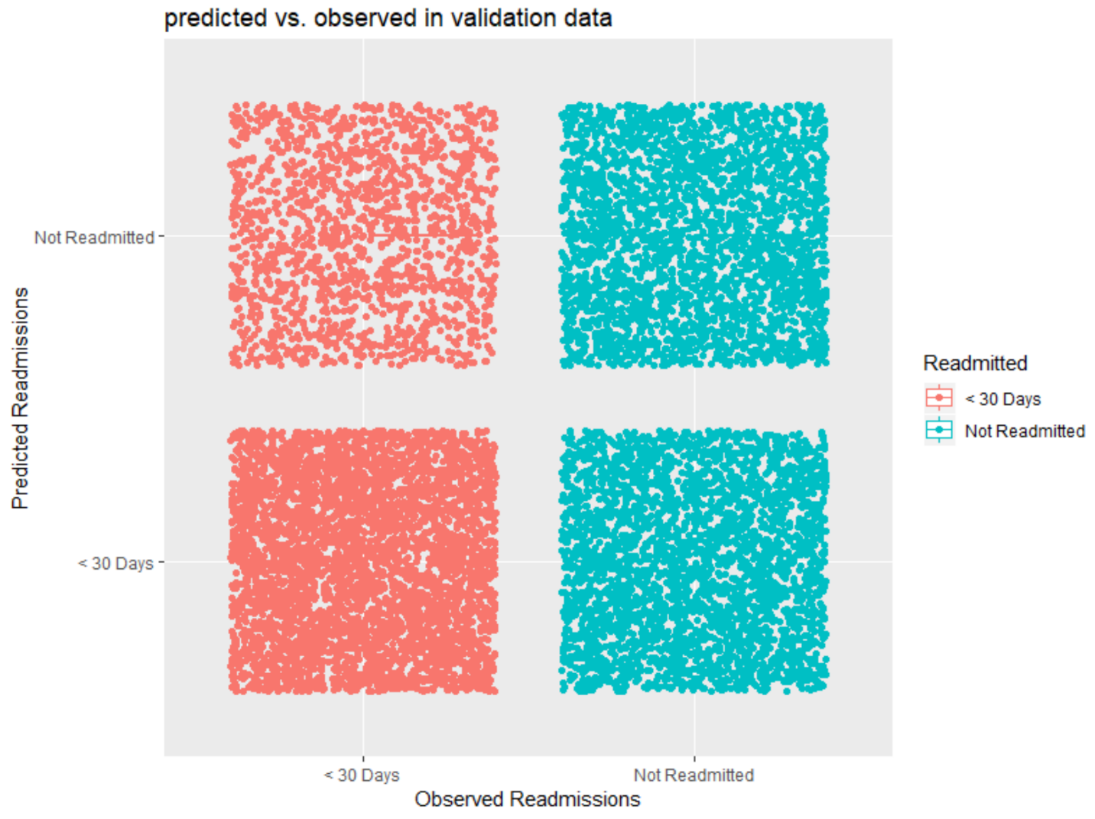
Methodology
The best accuracy with 58% accuracy was provided by the e1071 package NB function with all variables. Has fewer misclassifications of the readmission variable. When the number of variables is reduced or parameters were tuned, the accuracy rates go down.

Slide 31
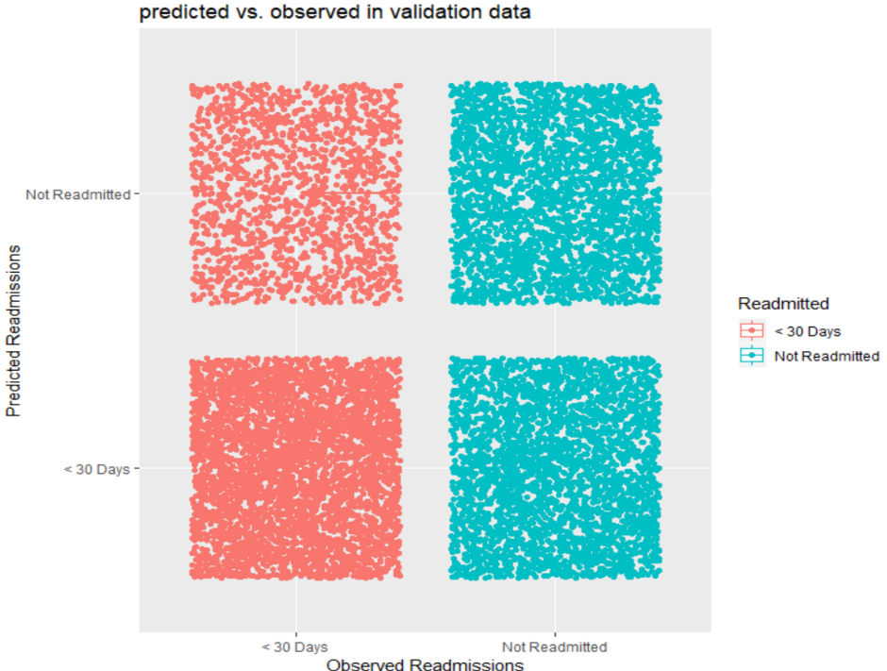
Methodology
With SVM classification, 60% accuracy was achieved. This performed better than the NB model. Also, the best accuracy was achieved using the linear kernel at a cost of 0.1.

Slide 32
Achievements
The project provided an opportunity to collect external data, converting it by cleaning, transforming and modeling with the objective of identifying useful information, suggesting collections and supporting decision making.
The result indicates the importance of using different data mining techniques to develop accurate prediction models.
Weighing the benefits of application of each machine learning models, can reduce the computation costs and provide the greatest precision.
Even though the data used in the project was highly sensitive, but it does not contain any personal details like name or phone number or home address, through which an individual can be identified. It mostly contains the different characteristics and hospital admission details of the individual.

Slide 33
IST 659 – Data Admin Concepts & Database Management
Online Pizza Database

Slide 34
Introduction
In this project, I build a database for a pizza company for online ordering application. I have created the Entities and the Attributes, Conceptual Model, Normalized Logical Model, and various SQL DDL commands to create tables using create table, stored procedure to create tables, view, insert statements. SQL DML select statements. I have used R Studio to create bar chart to compare the Guest vs Registered Customer.
Programming – SSMS, R Studio, Draw.io

Slide 35
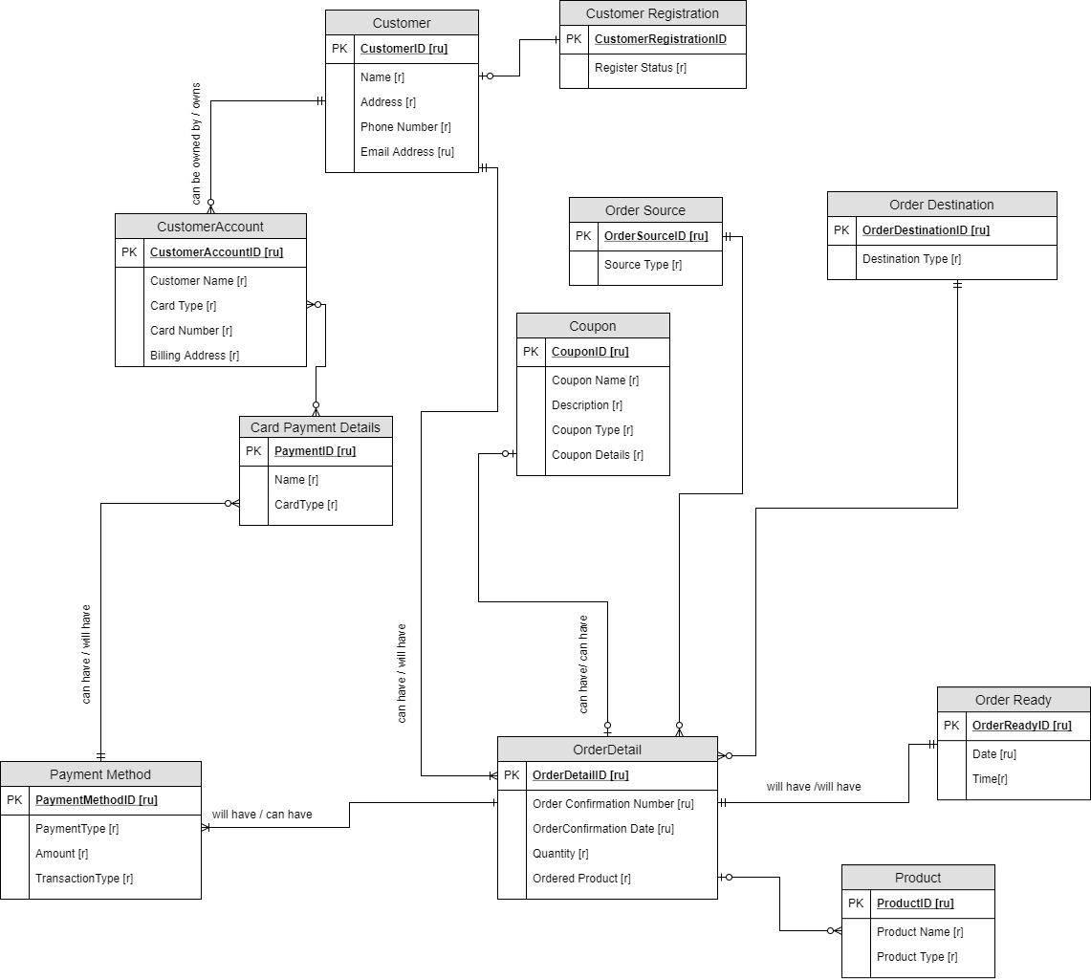
Conceptual Model
First, all the entities and the attributes are created and the required and required unique attributes are identified for each entity. Then a conceptual model was created using the entity-attribute table.

Slide 36
Normalized Logical Model
The conceptual model was then normalized and a normalized logical model was created by defining all the columns, primary key, foreign keys, and the relationships as shown in the picture.

Slide 37
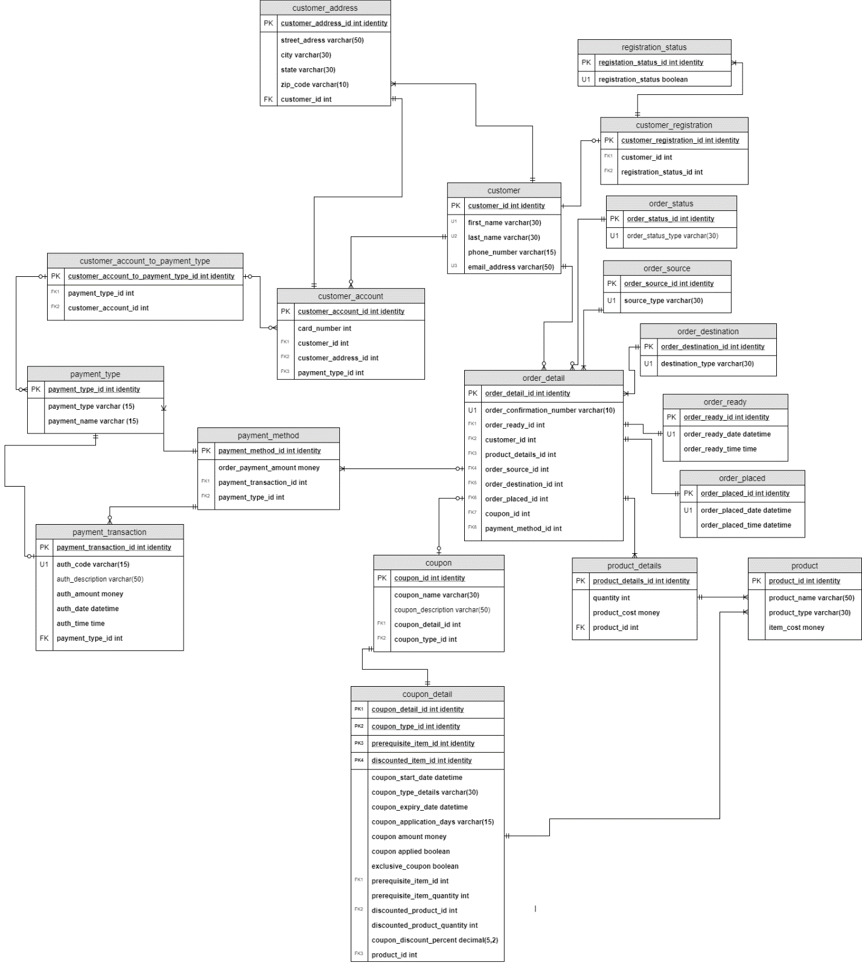
Normalized Logical Model

Slide 38
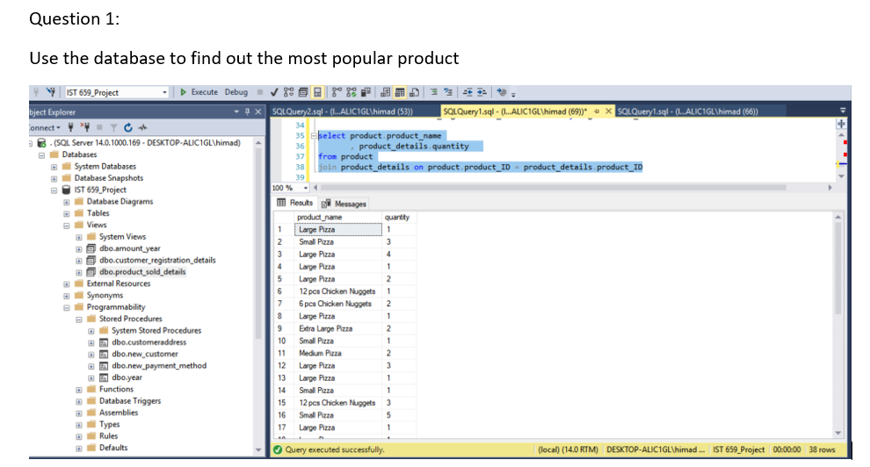
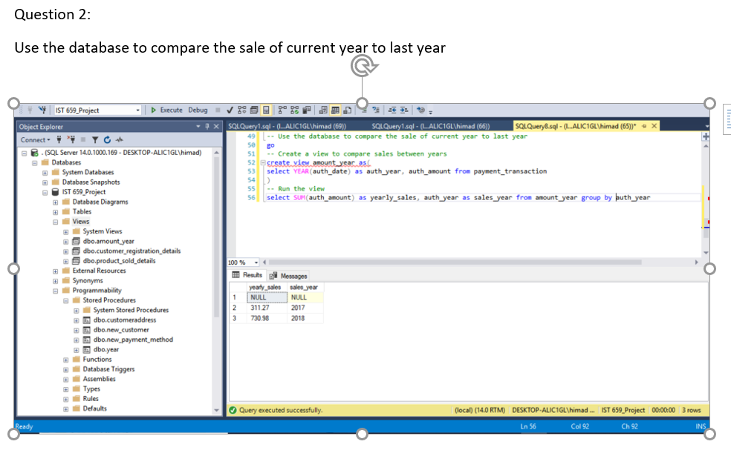
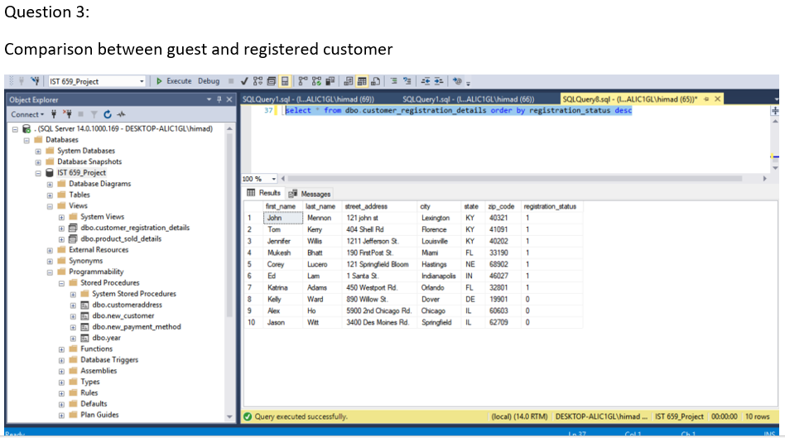
Problem Statements

Slide 39
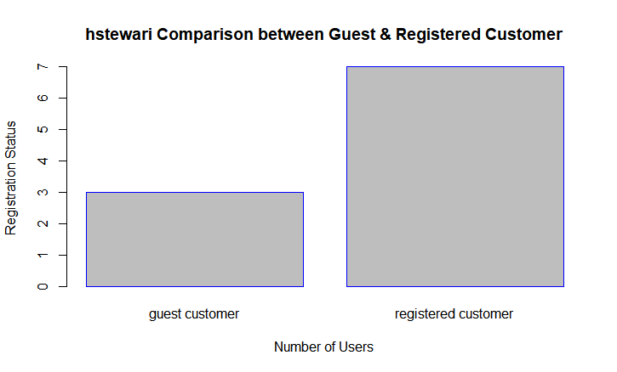
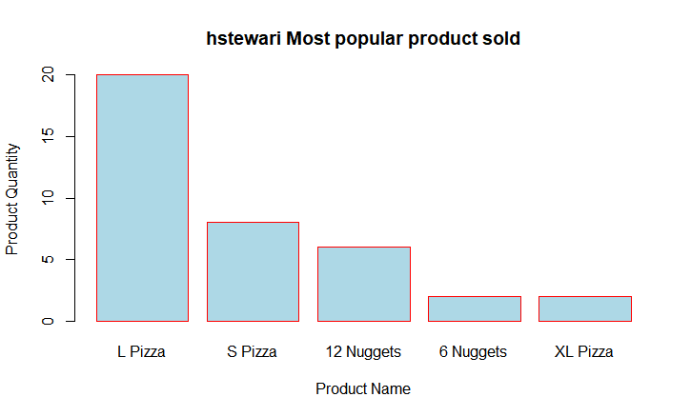
GUI Prototype
Using RODBC package, a connection was established to SQL Server using 64-bit DSN and the following bar charts were plotted on R Studio.

Slide 40
Achievements
The project help to develop data management skills
The data management solution signifies how the data is stored, organized and can be accessed for data analysis and data science
The database was created using a very common concept of the pizza company and the data stored are not real-time data and are mostly test data used to create the database. It would not affect any pizza making company.

Slide 41
Conclusion
The School of Information Studies provides the students with the required skills to effectively apply analytical skills and develop approach to solve complex data problems.
The skills learned from the program help the students to collect, organize, analyze and suggest actionable insights using various machine learning and data mining techniques.
Throughout the course, it fosters students to make suggestions and take decisions by applying analytical concepts to the data.

